Slide 1
Satisfactory Budget Division

Slide 2

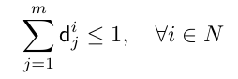
Introduction
n agents, m projects.
Total budget of 1(normalized).
Each agent has an opinion on the budget to be spent on each project.
These give minimum budget on project j that satisfies i.
P ,
d(i,j1)>d(i,j2) doesn’t necessarily mean that i values project j1 more than j2.
Has many applications like organizations(library, company, university) investing their budget on various projects.
More globally, an agent is said to be satisfied(or covered) by x if they are locally satisfied for at least τ projects, where the threshold τ∈[1,m] is a parameter belonging to the problem’s input.

Slide 3
Contributions
What fraction of agents can be satisfied for any given instance.
Which classes of instances can have a solutions that satisfy all agents.
For a given instance, what is the difficulty of deciding whether all agents can be satisfied?
What is the smallest total budget (possibly smaller or larger than 1) to satisfy all agents?
Note: the paper discusses the following values of τ
1
m/2(at least half scenario)
m-1(all but one)
m
m is the no. of projects

Slide 4
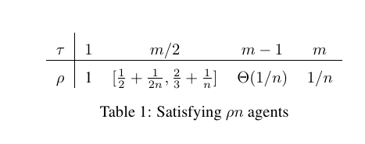
What fraction of agents can be satisfied for any given instance.

Slide 5
Classes of Instances Where All Agents Can Be Satisfied
At-least half scenario(τ =m/2)
This also holds for every instance having at most 2 projects, for any number of agents.
When τ =1, all agents can be satisfied with any arbitrary distribution with sum=1.
When τ =m, only one agent can be satisfied (all agents are satisfied only when everyone has the same demand vector).

Slide 6
Satisfying All Agents of a Single Instance

Slide 7
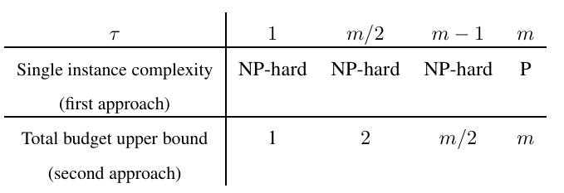
Minimizing the Total Budget Spent

Slide 8
Open Problems
How hard is the problem of maximizing the number of satisfied agents with a budget-feasible solution?
If outputting a probability distribution over several budget feasible solutions is possible, Then what would be the best possible expected fraction of satisfied agents?

